Slide 1
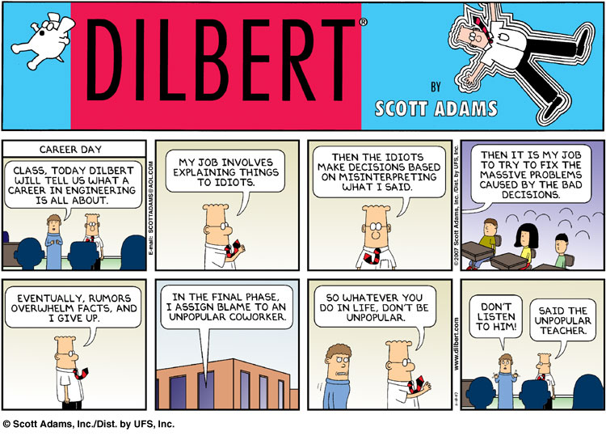

Slide 2
Templates
Zybooks 13

Slide 3
Function Templates
Writing/ Maintaining redundant functions that only differ by data type can be time consuming and error-prone
Function Template – a function definition of special type parameter that can adapt to different data types.
template<typename TheType>
or
template<class TheType>
TheType - type parameter. Can be any identifier/ variable name

Slide 4
Function Templates
Function Template Setup:
template<typename TheType>
TheType functionName(TheType item1, … )
{
…
return retVal; // of TheType type.
}
The compiler automatically generates a unique function definition for each type appearing in function calls to the function template …

Slide 5
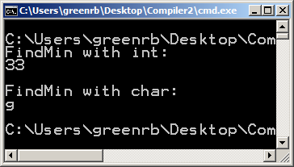
Function Templates Example:
template<typename TheType>
TheType FindMin(TheType item1, TheType item2)
{
TheType minItem = item1;
if(item2< minItem)
minItem = item2;
return minItem;
}
int main(){
int num1 = 55;
int num2 = 33;
char ch1 = ‘g’;
char ch2 = ‘m’;
cout << “FindMin with int:”<<endl;
cout << FindMin(num1,num2)<<endl;
cout <<endl;
cout << “FindMin with char:”<<endl;
cout << FindMin(ch1,ch2)<<endl;
cout <<endl;
return 0;
}

Slide 6
Function Templates
Function templates with multiple types
template<typename T1, typename T2, … >
T1 functionName(T1 var1, T2 var2, …)
{
…
return someVal; // of type T1
}

Slide 7
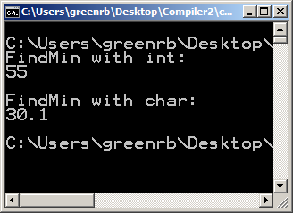
Function Templates Example:
template<typename T1, typename T2>
T2 FindMin(T1 item1, T2 item2)
{
T2 minItem = item1;
if(item2< minItem)
minItem = item2;
return minItem;
}
int main(){
int num1 = 55;
int num2 = 33;
double d1= 55.5
double d2 = 30.1
cout << “FindMin with int:”<<endl;
cout << FindMin(num1,d1)<<endl;
cout <<endl;
cout << “FindMin with char:”<<endl;
cout << FindMin(num2,d2)<<endl;
cout <<endl;
return 0;
}

Slide 8
Class Templates
Classes you create could be almost identical, if it were not for the differing data types.
Using templates for classes allows for a class that you write to be able to handle different data types.
Class template – a class definition having a special type parameter that may be used in place of types in the class.
NOTE: A variable defined of that class type must indicate a specific type (more in the upcoming slides)

Slide 9
Class Templates Example
template<typename type1>
class array{
private:
type1 data[2];
public:
array(type1, type1);
void print();
};
template<typename type1>
array<type1>::array(type1 val1, type1 val2){
data[0] = val1;
data[1] = val2;
}
template<typename type1>
void array<type1>::print(){
for(int i = 0; i<2; i++)
cout << i <<". " << data[i] << endl;
cout <<endl;
}

Slide 10
Class Templates Example
template<typename type1>
class array{
private:
type1 data[2];
public:
array(type1, type1);
void print();
};
template<typename type1>
array<type1>::array(type1 val1, type1 val2){
data[0] = val1;
data[1] = val2;
}
template<typename type1>
void array<type1>::print(){
for(int i = 0; i<2; i++)
cout << i <<". " << data[i] << endl;
cout <<endl;
}
Template call used before class definition as well as function implementation

Slide 11
Class Templates Example
template<typename type1>
class array{
private:
type1 data[2];
public:
array(type1, type1);
void print();
};
template<typename type1>
array<type1>::array(type1 val1, type1 val2){
data[0] = val1;
data[1] = val2;
}
template<typename type1>
void array<type1>::print(){
for(int i = 0; i<2; i++)
cout << i <<". " << data[i] << endl;
cout <<endl;
}
In addition, function implementation needs <type> before the :: of the function definition

Slide 12
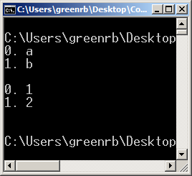
Class Templates Example
int main()
{
array<char> charType(‘a’,’b’);
array<int> intType(1,2);
charType.print();
intType.print();
return 0;
}

Slide 13
Class Templates Example
int main()
{
array<char> charType(‘a’,’b’);
array<int> intType(1,2);
charType.print();
intType.print();
return 0;
}
A variable defined of that class type must indicate a specific type

Slide 14
Templates Questions
Fill in the blank:
template<typename MyType>
_______ MyAvg3(MyType i, MyType j, MyType k){
return (i + j + k)/3;
}

Slide 15
Templates Questions
Fill in the blank:
template<typename MyType>
_______ MyAvg3(MyType i, MyType j, MyType k){
return (i + j + k)/3;
}
MyType

Slide 16
Templates Questions
Fill in the blank:
template<typename ____________>
T TripleMin(T item1, T item2, T item3){ ... }

Slide 17
Templates Questions
Fill in the blank:
template<typename ____________>
T TripleMin(T item1, T item2, T item3){ ... }
T

Slide 18
Templates Questions
For the earlier FindMin function from the function template section above, what happens if a call is FindMin(i, j) but those arguments are of type long long?
The compiler generates an error message because only int and char are supported
During runtime, the long long values are forced to be int values
The compiler creates function with long long types and calls that function

Slide 19
Templates Questions
For the earlier FindMin function from the function template section above, what happens if a call is FindMin(i, j) but those arguments are of type long long?
The compiler generates an error message because only int and char are supported
During runtime, the long long values are forced to be int values
The compiler creates function with long long types and calls that function

Slide 20
Templates Questions
For the earlier FindMin function from the function template section above, what happens if a call is FindMin(i, j) but those arguments are of type string?
string is just another type, so the function will compare strings
The compiler generates an error, because only numerical types can be passed.

Slide 21
Templates Questions
For the earlier FindMin function from the function template section above, what happens if a call is FindMin(i, j) but those arguments are of type string?
string is just another type, so the function will compare strings
The compiler generates an error, because only numerical types can be passed.

Slide 22
Templates Questions
For the earlier FindMin function from the function template section above, what happens if a call is FindMin(i, j) where i is an int but j is a string?
The function will compare the int to the string
The compiler generates an error, because TheType must be the same for all arguments

Slide 23
Templates Questions
For the earlier FindMin function from the function template section above, what happens if a call is FindMin(i, j) where i is an int but j is a string?
The function will compare the int to the string
The compiler generates an error, because TheType must be the same for all arguments

Slide 24
Templates Questions – True or False
A class has been defined using the type GenType throughout, where GenType is intended to be chosen by the programmer when defining a variable of this class. The code that should immediately precede the class definition is template<GenType>

Slide 25
Templates Questions – True or False
A class has been defined using the type GenType throughout, where GenType is intended to be chosen by the programmer when defining a variable of this class. The code that should immediately precede the class definition is template<GenType>
FALSE
The keywords “typename” or “class” are missing. The code should be
template<typename GenType>

Slide 26
Templates Questions – True or False
A key advantage of a class template is relieving the programmer from having to write redundant code that differs only by type.

Slide 27
Templates Questions – True or False
A key advantage of a class template is relieving the programmer from having to write redundant code that differs only by type.
TRUE
Great example of where this is used is the vector class – the same code handles numerous different data types

Slide 28
Templates Questions – True or False
For a class template defined as
Template<typename T> class Vehicle { . . . }
an appropriate variable definition of that class would be
Vehicle<T> v1;

Slide 29
Templates Questions – True or False
For a class template defined as
Template<typename T> class Vehicle { . . . }
an appropriate variable definition of that class would be
Vehicle<T> v1;
FALSE
“T” is the generic type used in the class template, acting as a placeholder for the actual type. A variable definition must now specify the actual type, such as
Vehicle<int> v1;

